Slide 1
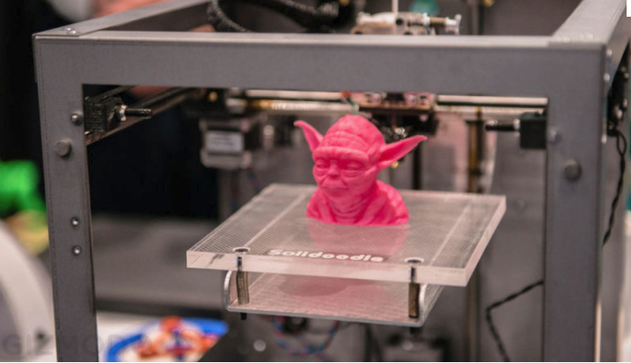
3D PRINTING M.DRUMARE

Slide 2
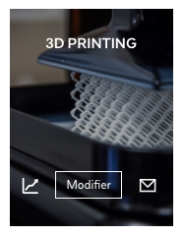
ON FLIPBOARD
http://flip.it/gUp9Ko

Slide 3
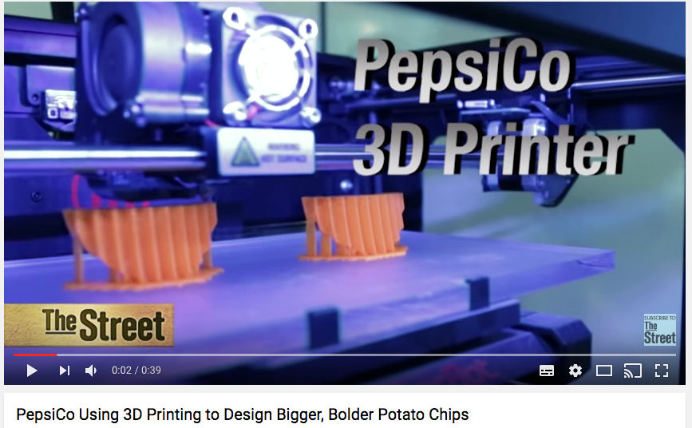
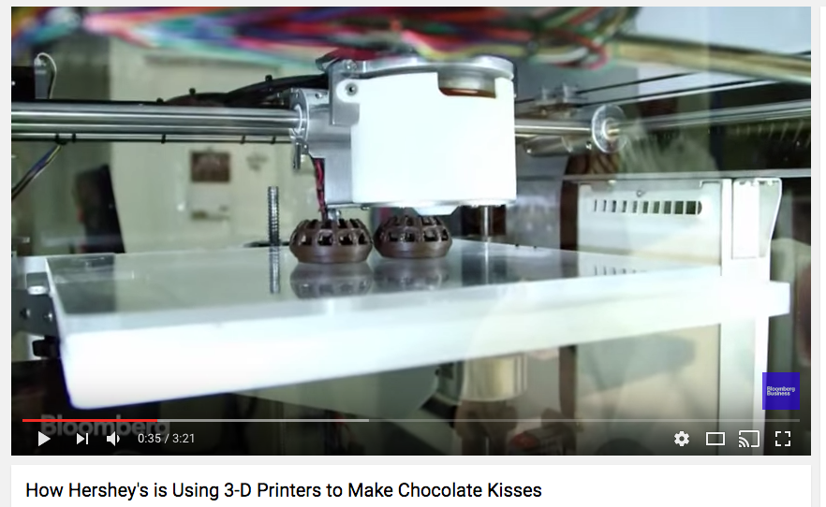
FOOD PRINTING

Slide 4

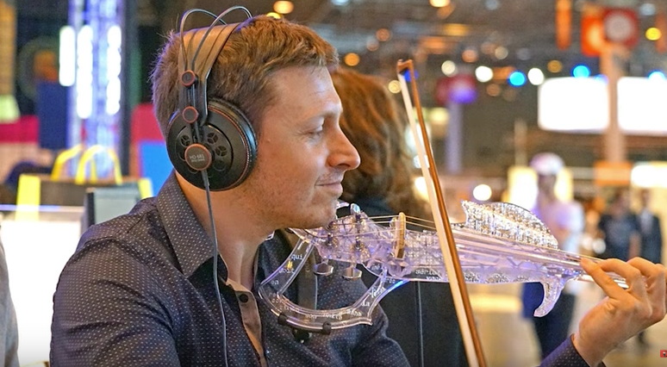

3D PRINTING FOR EVERYTHING, FOR ALL
17 Incredible 3D Printed Objects

Slide 5
WHAT ?

Slide 6
WHAT IS ADDITIVE MANUFACTURING?
Additive Manufacturing (AM) refers to a process by which digital 3D design data is used to build up a component layers by depositing material
The term ‘3D printing’ is increasingly used as a synonym for AM. However, the latter is more accurate in that it describes a profesional production technique which is clearly distinguished. From conventionel methods of material removal
Make Your Own Products with 3D Printing
What Is 3D Printing and How Does It Work?

Slide 7
WHY USE AM?
Fast prototyping
Reduce the cost of production
Complex geometries
Part consolidation
Multiple materials, news materials
Enhanced performance (weight, flexibility, strenght, thermal management, etc)
Low-volume manufacturing: market testing, product differentiation, personalization
Increased supply chain efficiency, reduce inventory
Opel Reduces Assembly Tool Costs
By Up to 90%
Realistic and quick prototyping

Slide 8
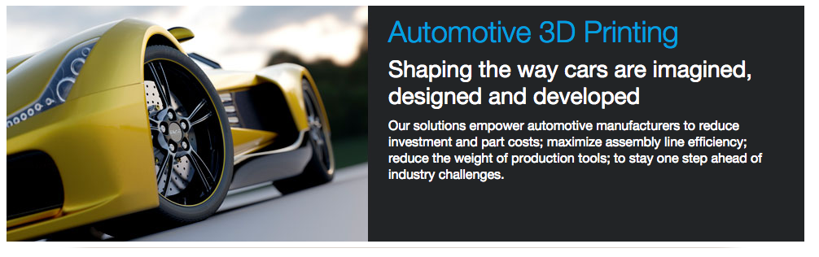
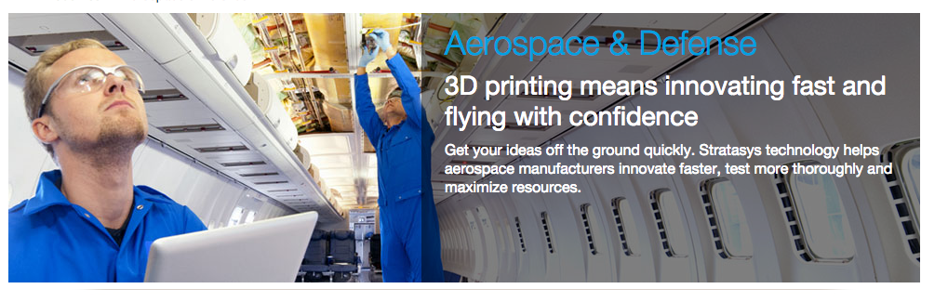
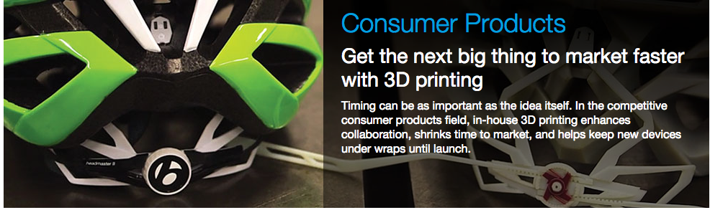
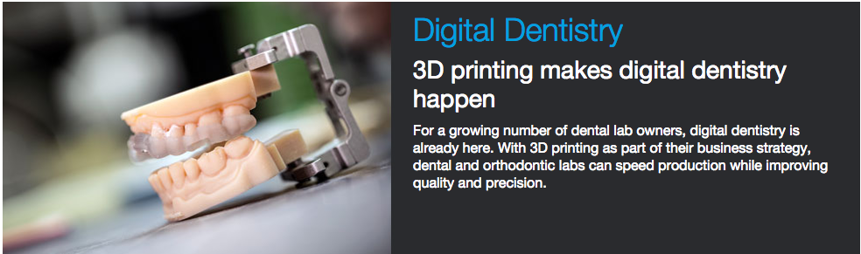
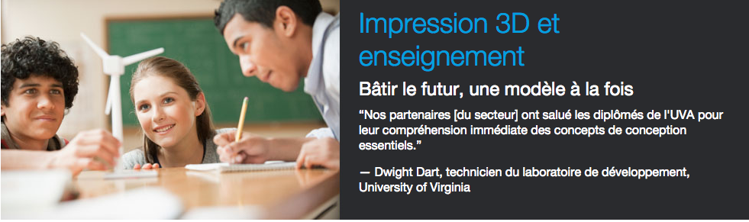
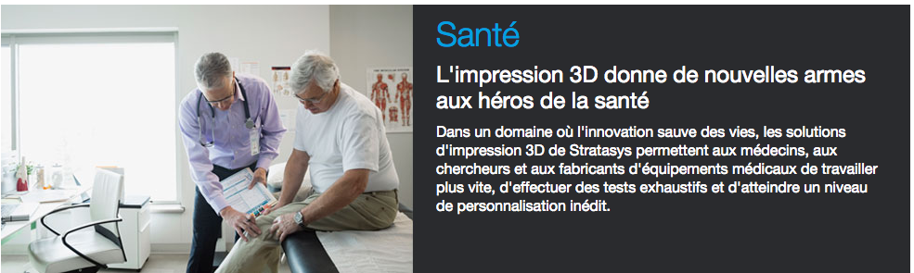
INDUSTRY USE

Slide 9
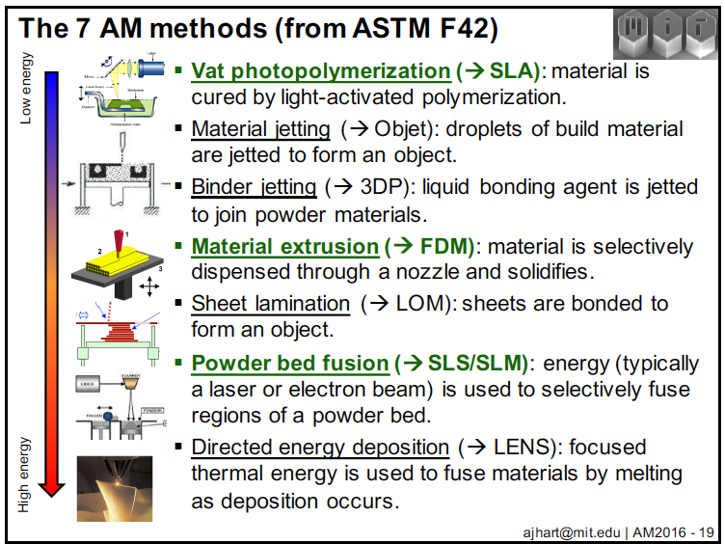
7 AM Methods

Slide 10
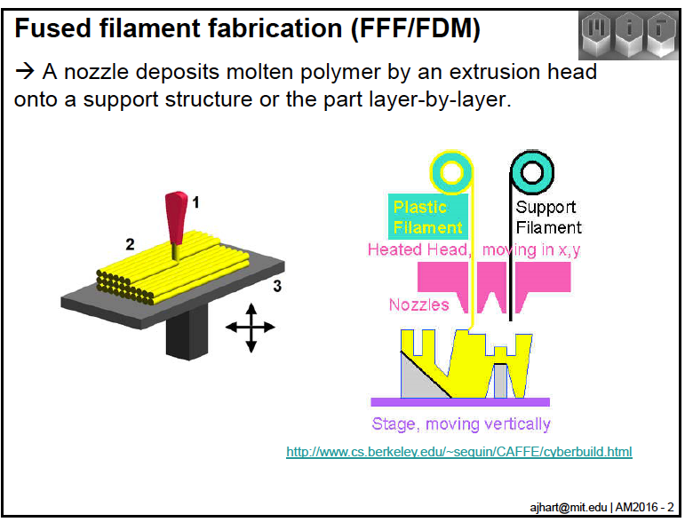
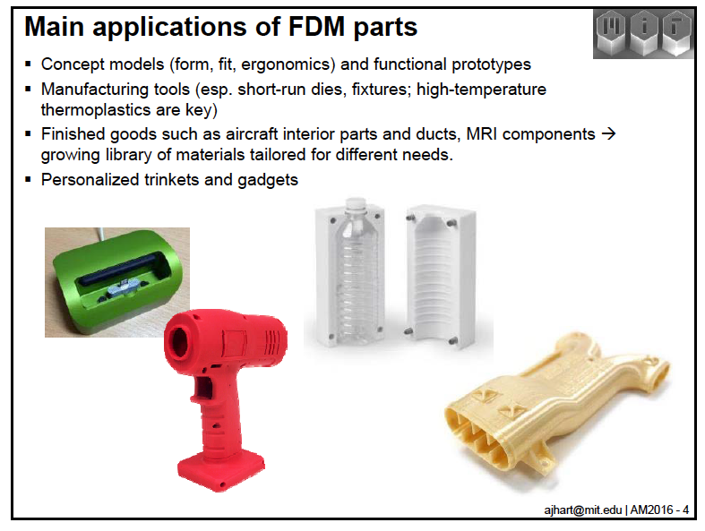
MATERIAL EXTRUSION (FDM)
Material extrusion
MakerBot Smart Extruder+ | Print with Confidence

Slide 11
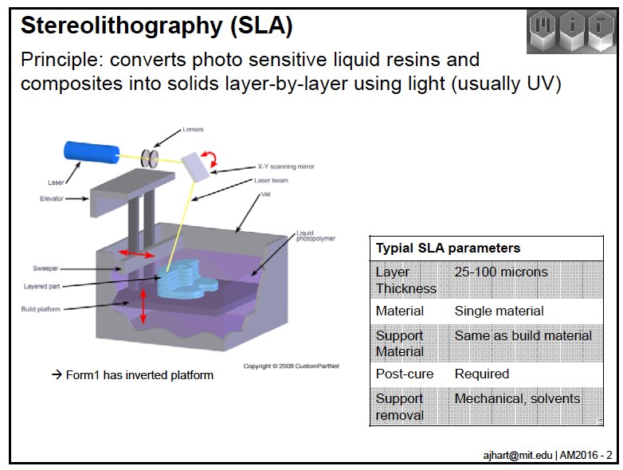
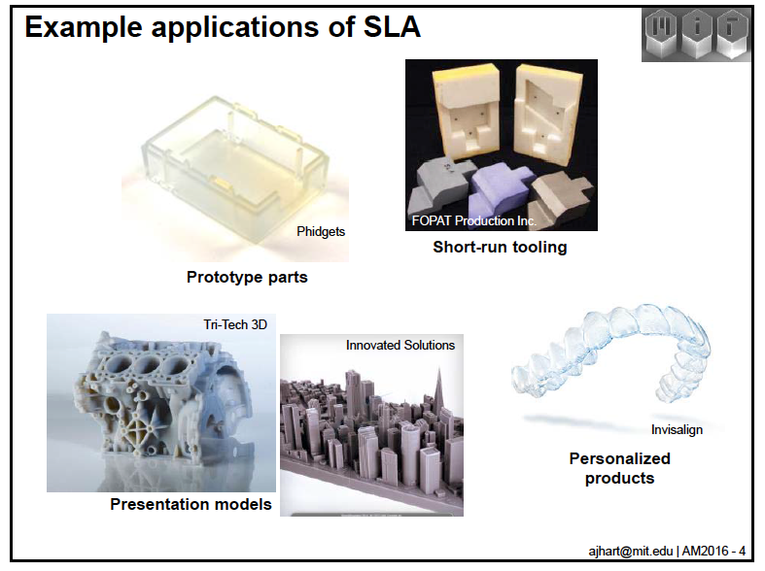
VAT PHOTOPOLYMERIZATION (SLA)
Stereolithography (SLA) Technology
Align Technology 2015

Slide 12
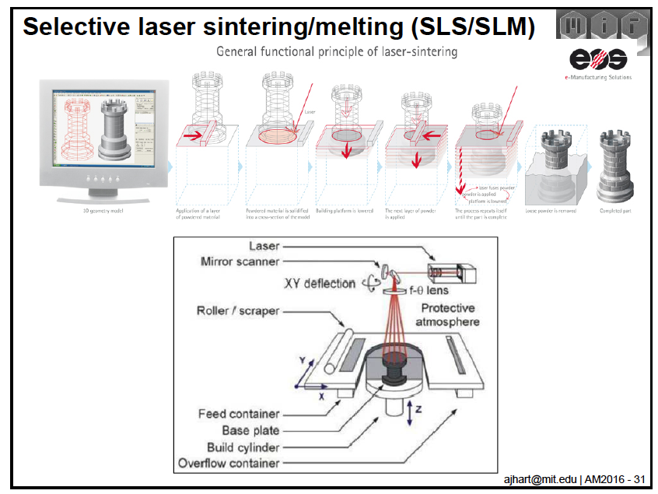
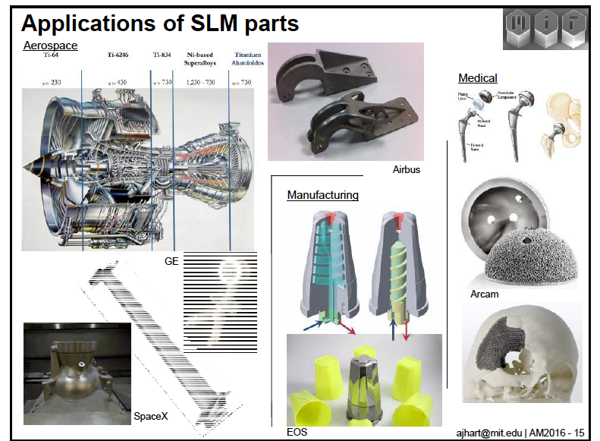
POWDER BED FUSION (SLS/SLM)
Design Dictionary: Powder Bed 3D Printing
Powder bed fusion

Slide 13
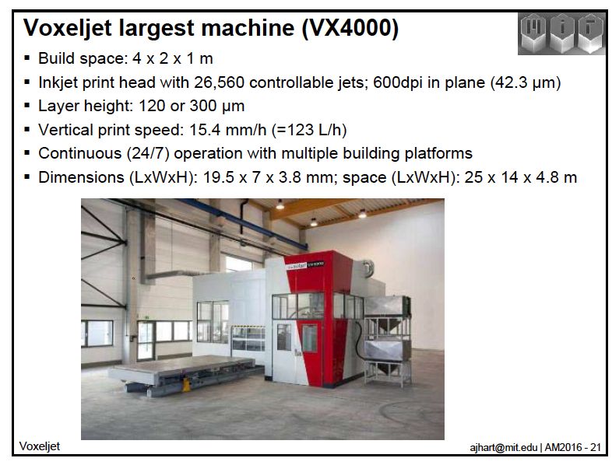
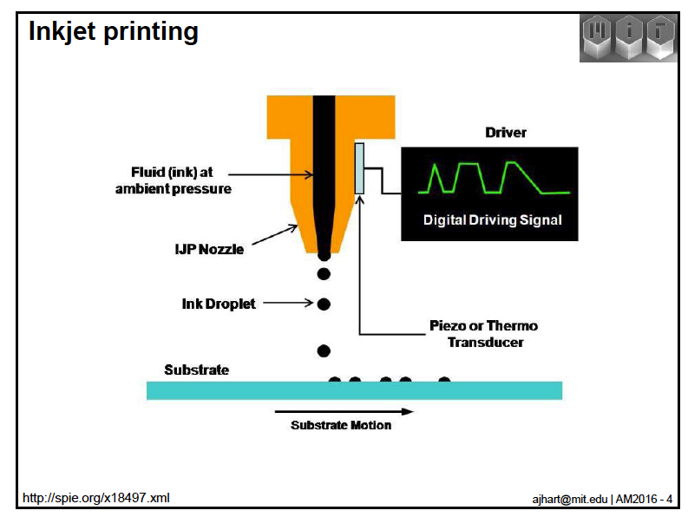
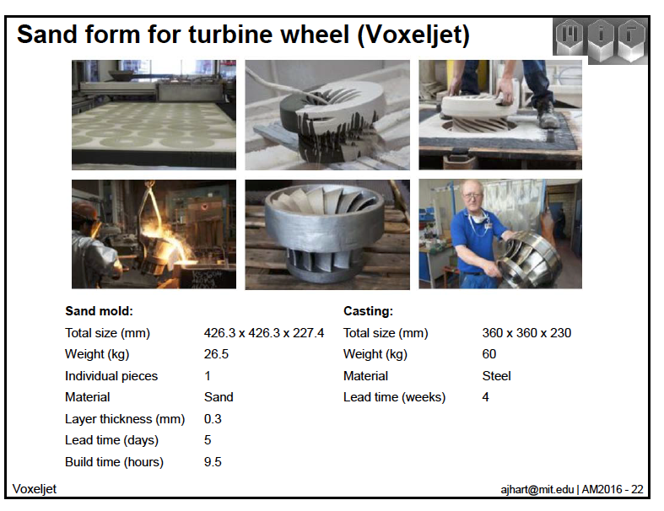
JETTING-BASED AM PROCESS
VX4000 sand process

Slide 14
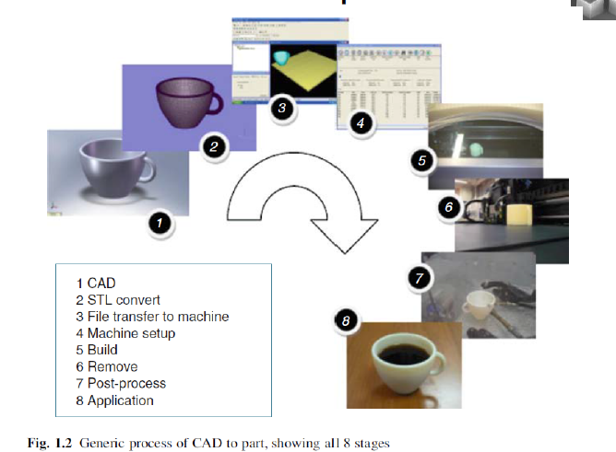
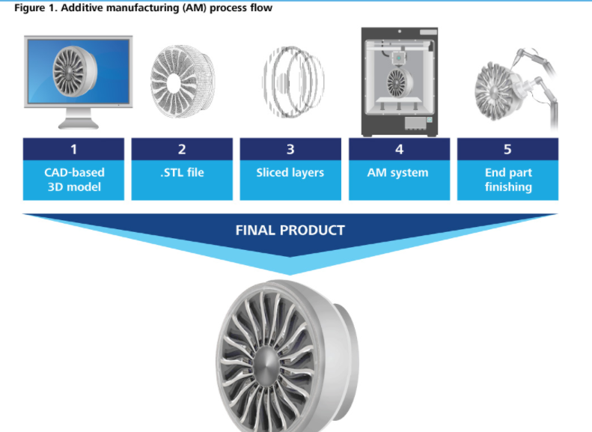
STAGES OF A 3D PRINTING PROCESS
How to 3D Print | The 3D Printing Process

Slide 15
WHY IS AM THE BIG THING NOW?
Software (especially wide adoption of CAD/CAE)
Improved (and lower cost) electromechanical components
A wider range of printable materials (filaments, powders, phocurable resins, etc)
Experation of cornerstone process patents
More proven results
Favorable industry and public mindset
Global Economy Competition (new generation of makers)
IoT, Robotics, Industry 4.0
Printable Hydraulic Robots

Slide 16
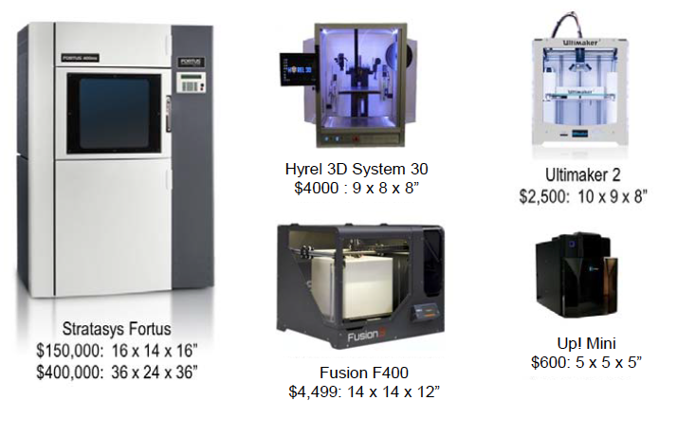
AM INDUSTRY TODAY
In 2005 : 80 patents vs 600 patents in 2013
(Stratasys, 3D Systems, Xerox, Therics (medical devices), GE and IBM.
In 2014 sales of industrial 3D printers in the USA were 1/3 the volume of industrial automation and robotic sales. Some projections have figure rising to 42% by 2020 (Pwc, 2014).
Viable alternative to conventional manufacturing processes for GE, Google, Boeing, Aurora Flight, Invasalign, Airbus, Siemens, LuXeXcel.
Printable material continues to expand : ceramics, cement, glass, carbon.
Next Challenge : establish standards.

Slide 17
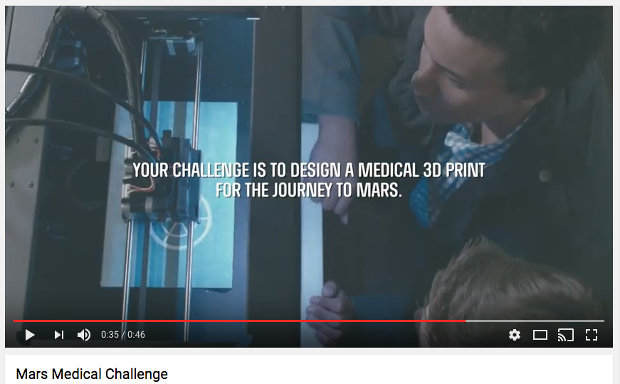
ON THE ROAD TO MARS

Slide 18
HOW ?

Slide 19
DEFINE A NEW STRATEGY
How the AM can add value to my product?
Better design, Better quality, Lighter, Lower Cost, Personnalization, Fuel-Efficient, Ecological ?
How to revisit the manufacturing process?
How, where, when products and parts are fabricated?
How to implement a new commercial eco-system?
Design, print operations, quality control, printer networks.
Coordination between this manufacturing platform and the market demand.

Slide 20
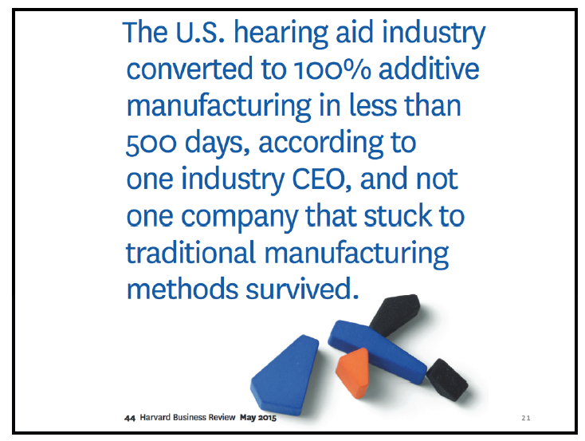
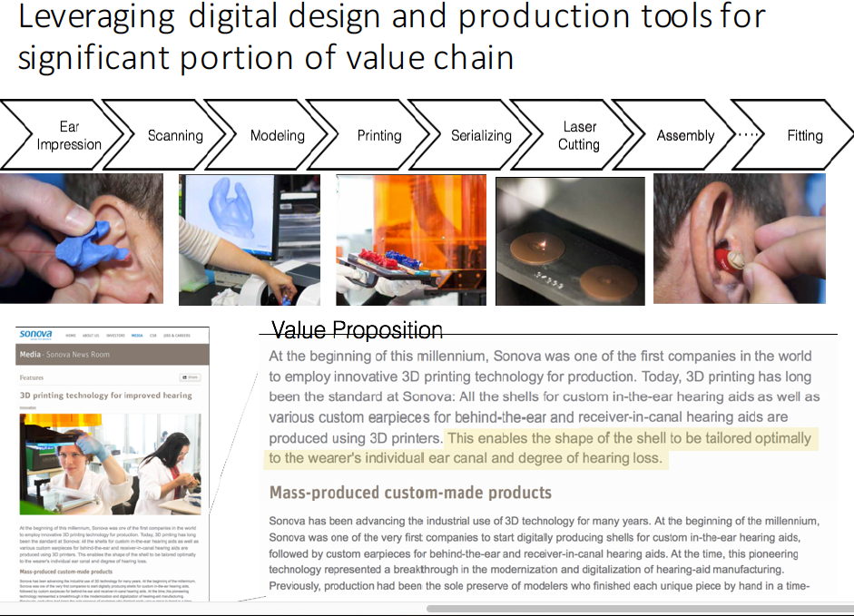
ANTICIPATE THE AM IMPACT ON BUSINESS

Slide 21
GET YOUR ORGANIZATION READY FOR AM
Gather knowledge from the outside: universities, AM Providers, Governmental laboratories.
Move step by step : build expertise and reduce internal resistance.
Focus and prioritize : build up small wins ans feasable choices.
Keep an eyes on the long run : look for cost and supply chain opportunities.

Slide 22
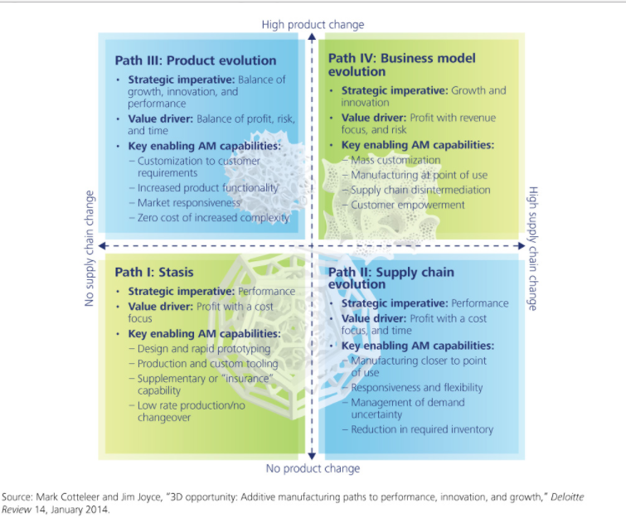
CHOOSE THE RIGHT PATH OF INNOVATION
Path 1: AM Technologies Exploration
Path 2: Scale Economics offered by AM
Path 3: FOCUS ON Product Evolution
Path 4: New Bussiness Model

Slide 23
DO COST ANALYSIS « AM VS TRADITIONAL »
Manufacturing Costs
GE Aviation has switched to printing the fuel nozzles of certain jet engines. Printing Technology allows a nozzle that used to be assembled from 20 separately parts to be fabricated in on epiece. This will cut the cost of manufacturing by 75% .
Life Cycle Costs
3D printing Hinge Bracket reduce the weight per plane by 10kg
(fuel effeciency x 40 years).

Slide 24

START WITH HIGHT-END PRODUCT
Creating Luxury products for customers that appreciate the Innovation and flexibility.
Waiting for the maturity and cost effectiveness of AM.
Growing experience among the engineers
Spot the opportunities to make parts for mass-market segment.
Automotives Industry: Concept Cars, BMW choose Rolls-Royce.
Rolls-Royce Designers See a Luxurious Future in Personalized, 3D Printed Exteriors
https://goo.gl/0AS7FX

Slide 25
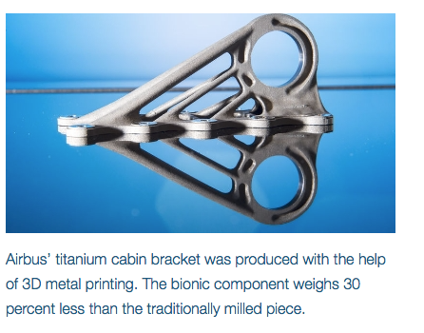
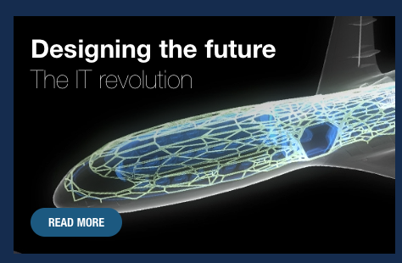
START WITH COMPONENT OF A GIVEN PRODUCT
Focusing first on the component of a given product
Easier to migrate to Additive Manufacturing
Developping organization know-how
Advancing to more-challenging components of the same product.
Aerospace: Airbus from the bracket to the exterior skin.

Slide 26
ESTABLISH A 3D-FOOTHOLD
Finding components that show up in multiple products and use them to establish a 3D-foothold.
Building knowledge and awareness on how AM can enhance the performance.
Defense Industry: A design improvement for a fighter jet can be transferred to drones, missiles or satellites.
Growing UAVs Through Chemistry

Slide 27
IMPACTS ?

Slide 28
IMPACT ON LAW & INTELLECTUAL PROPERTY
Impact on Law and intellectual property: Just like file-sharing sites shook the music industry because they made it easy to copy and share music.
The ability to easily copy, share, modify and print 3D objects will ignite a new wave of intellectual property issues.Impact on human ressources
Will 3D Printing Break Copyright?

Slide 29
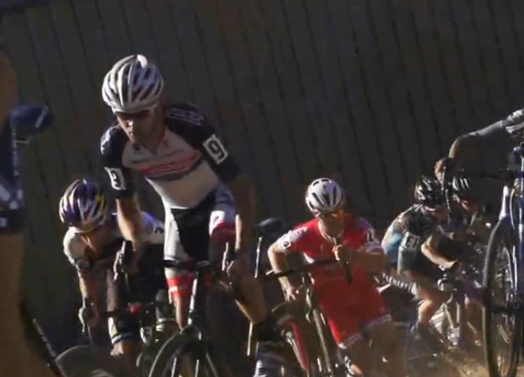
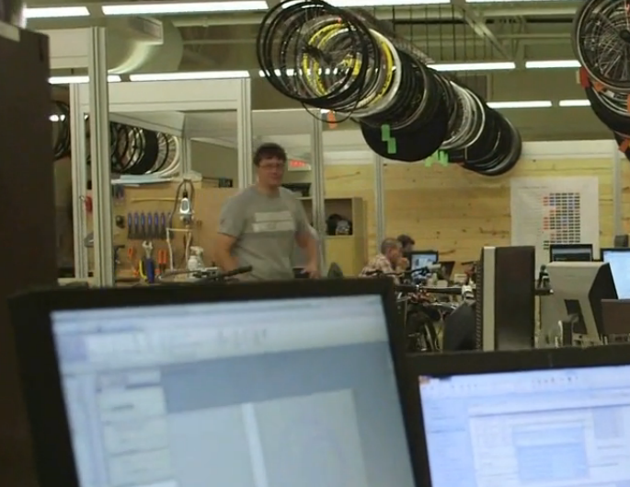
IMPACT ON R&D : FAST PROTOTYPING
Trek Uses Multi-Material 3D Printing
The bike-obsessed engineers at Trek use a color, multi-material 3D printer for realistic prototypes.
Treck rapid prototyping

Slide 30
IMPACT ON SUPPLY CHAIN
3D Printing on demand, low volume of complex and personalized product.
No finish product on shelves or stacked in warehouses anymore. No more « just in time inventory ».
The rise of robots and drones. Fast delivery with 3D Printed robots and delivery drones.
The Consumer Takes charge. Rather than plan, source, make, deliver, and return, a future supply chain model will start with the consumer order which will initiate make, deliver and return.
Digitizing the External Supply Chain, SAP

Slide 31
IMPACT ON MARKETING
Customers will need to connect more in-depth to a product when they have the ability to make it their own.
Brand and image will be key to maintaining a strong reputation in a 3D printing world. Growing importance of the social media.
Customization will become the norm: The customization potential of 3D printing will force companies to adjust their sales, distribution and marketing channels to take advantage of their capability to provide customization direct to the consumer.”
Use of 3D Printing in advertising.

Slide 32
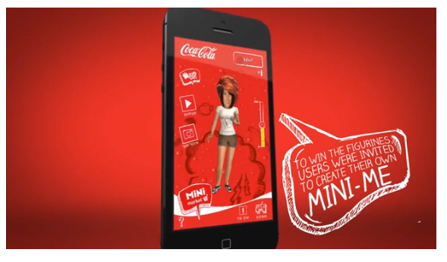
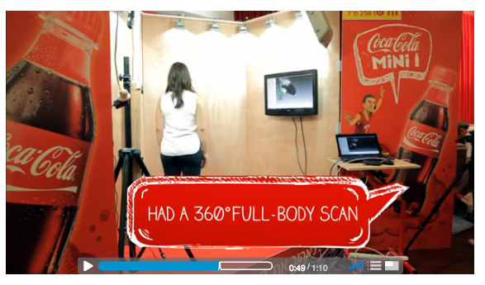
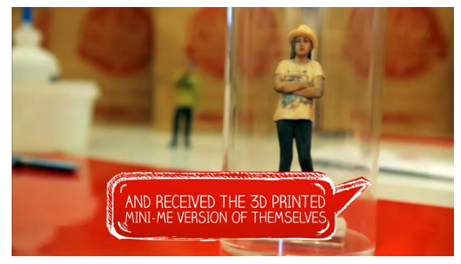
A NEW ADVERTISING TOOL
Coca-Cola wanted to introduce its new Mini Bottles in Israel.
The brand invited consumers to create tiny, digital versions of themselves in a mobile app, which they then had to tend to carefully, Tamagotchi-style
How Coke, VW, Nokia and Others Use 3D Printing in Marketing
https://goo.gl/6coRfP

Slide 33
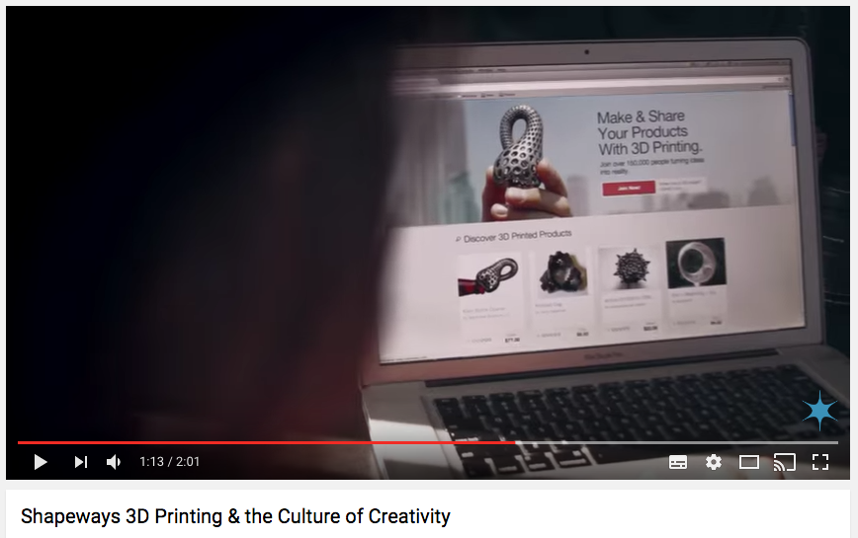
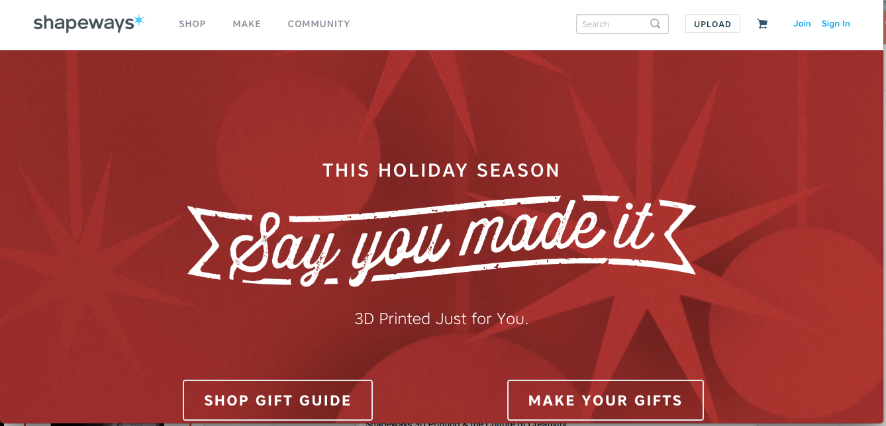

IMPACT ON E-COMMERCE: FROM E-BAY TO SHAPEWAYS
http://www.shapeways.com/

Slide 34
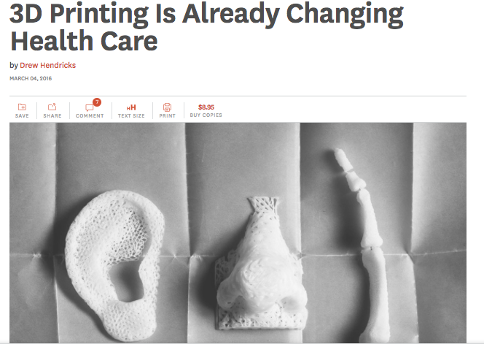
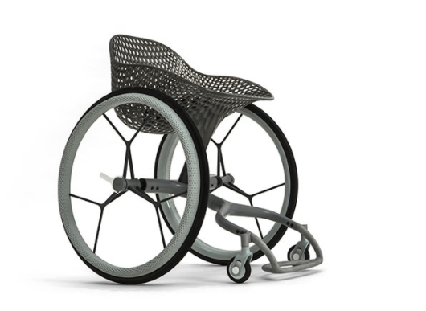
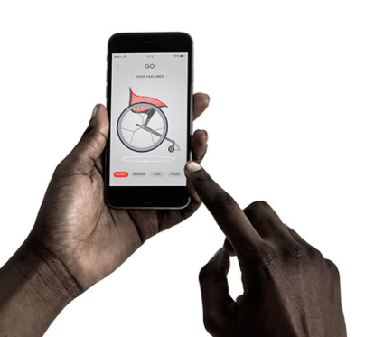
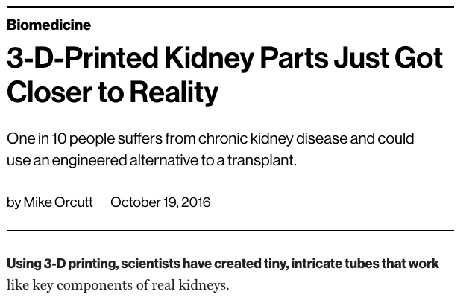
IMPACT ON HEALTH INDUSTRY (BIOTECH)

Slide 35
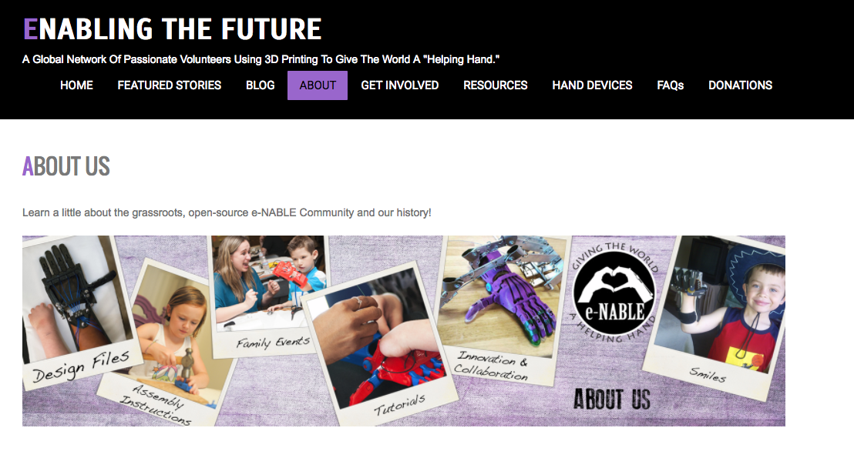
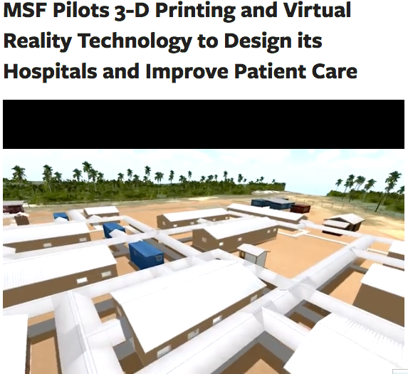
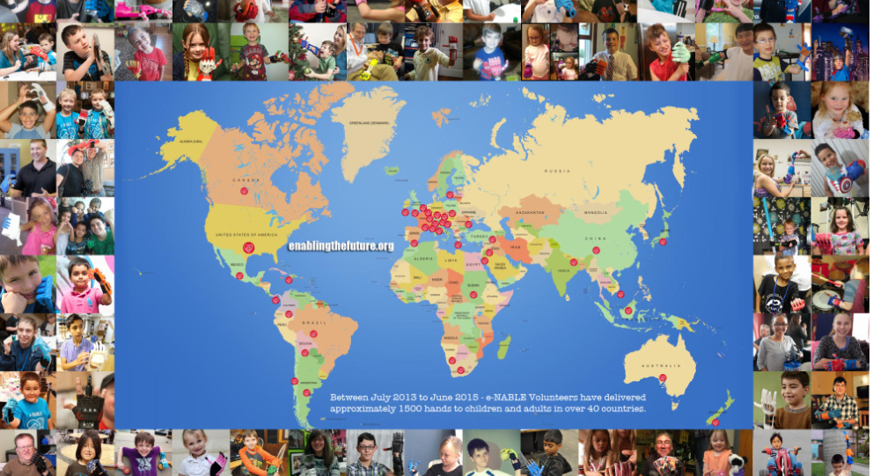
IMPACT ON HUMANITARIAN AID

Slide 36
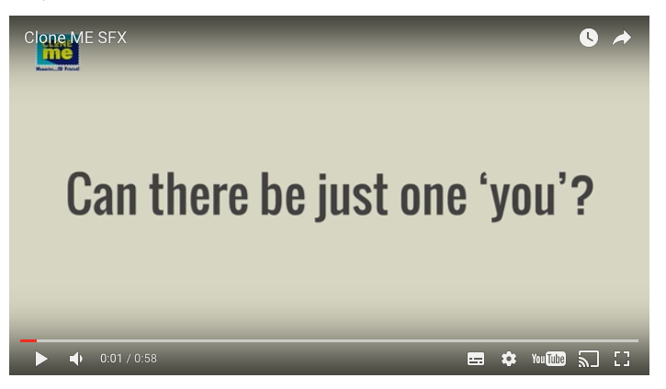
CLONE ME : 3D PRINTED SELFIES

